Slide 1


  PJP Master – DCODE: User Guide
Comprehensive Walkthrough of Permanent Journey Plan (PJP)
Digitize. Distribute. Transform.

Slide 2
Overview
Introduction | The objective of this user manual is to understand the intricacies of creating a permanent journey plan for PJP’s.
Duration | 15 minutes
Participants | DT User
Methodology
Last Updated | 06-Aug-2024
Version | 1.1
Market | Pakistan

Slide 3
Table Of Contents
Section – Create/Update
Selling Category – Create/Update
Introduction & Pre-Requisites
PJP Creation
PJP Creation – Approval
PJP Header – Update
PJP Configuration – Update
Conclusion

Slide 4
Introduction
Permanent journey plan (PJP) process is to optimize distribution management by enhancing efficiency and organization. IN DCODE, every Order booker & Delivery Man has a PJP. PJP is basically a journey plan designed taking into consideration the number of outlets (section), selling category, frequency (Weekly, Daily, etc) and the working days (Mon/Tues, etc.). All activities performed by the Order Booker are performed as per PJP plan assigned to them.
A selling category is a logical grouping of products, which can be used for managing day to day sales and goods delivery as well as targeted marketing and promotional activities.
A section is a group of outlets which are assigned to a DSR for handling their order booking or goods delivery activities.
PJP that are attached to the Order Booker will be downloaded to the Handheld for the sales person servicing the route, and he will have a list of customers to visit on any one day.
Pre-Requisites:
System Requirements: Basic understanding of personal computer usage and internet navigation. Furthermore, a fundamental knowledge of the operating system(s) installed on their personal computer(s) is expected.
User Access and Permissions: Obtain necessary login credentials from the system administrator.
Network and Connectivity: Ensure a stable and reliable internet connection.

Slide 5
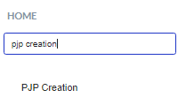
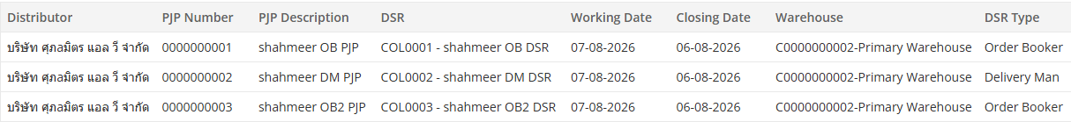
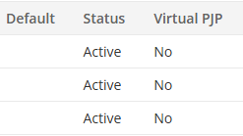
PJP Creation (1 of 7)
Search
Search for the PJP Creation into the search box located on the main page.
Home->Distributor Setup->Journey Plan->PJP Creation
Existing Records
All the existing created PJPs of Order Bookers and Delivery Persons will be displayed in the upper grid, the user can make the changes in previously created PJPs by clicking on the desired entry.
Note, in above grid, DSR can be Delivery Person/Order Booker. As a practice, it is advised to have DSR denoted by <DSR name>_OB, and Delivery Persons by <Delivery Person Name/ID>_DM so that it becomes easier for tracking purpose.

Slide 6
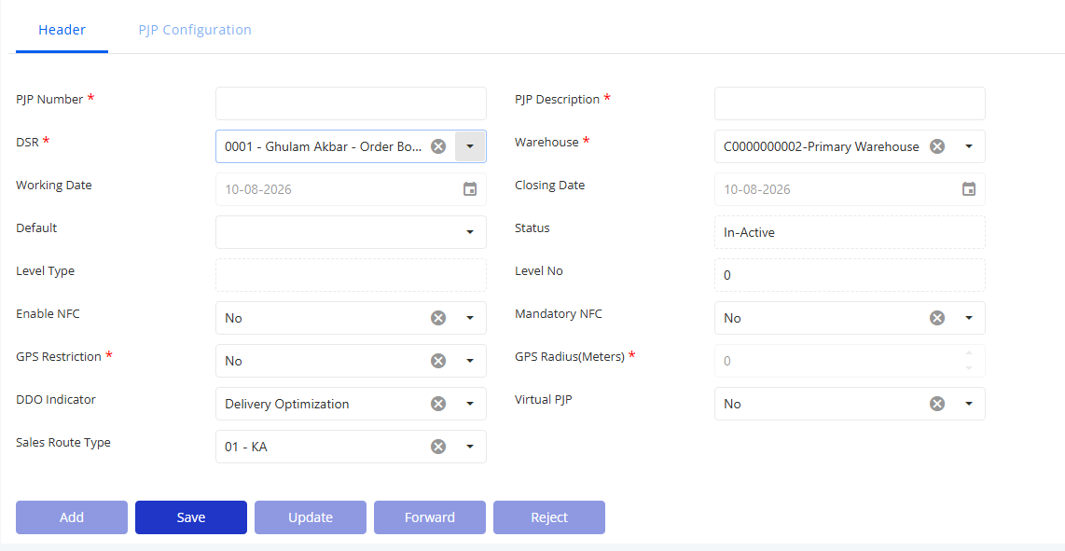
PJP Creation (2 of 7)
Fields Description
PJP Number: Enter a unique PJP number.
DSR: Select the Order Booker DSR from the dropdown
Working Date: Displays the working date associated with the PJP.
Default: Indicates whether the PJP is set as the default PJP.
Status: Indicates whether the PJP is active or inactive.
Level Type: Select the level type.
Enable NFC: Select Yes or No to enable or disable NFC functionality for the PJP.
GPS Restriction: Select Yes or No to enable or disable GPS restrictions for the PJP.
DDO Indicator: Indicates whether the PJP is associated with DDO functionality.
Sales Route Type: Select the sales route type applicable to the PJP.
Fields Description
PJP Description: Enter a description to identify or provide additional details about the PJP.
Warehouse: Select the warehouse associated with the PJP from the dropdown.
Closing Date: Displays the closing date of the PJP
Status: Indicates whether the PJP is active or inactive.
Level No: Enter the level number.
Mandatory NFC: Select Yes or No to indicate whether NFC verification is mandatory for the PJP.
GPS Radius (Meters): Enter the allowable GPS radius, in meters.
Virtual PJP: Indicates a virtual PJP used for B2B orders placed directly by an outlet. The implementation team creates the virtual PJP for such orders.

Slide 7
PJP Creation (2 of 7)
Fields Description
Add: Creates a new PJP record by allowing the user to enter the required details.
Save: Saves the entered PJP details to the system.
Update: Updates the existing PJP record with the latest changes.
Forward: Forwards the PJP record to the next stage of the approval workflow.
Reject: Rejects the PJP record and stops it from progressing through the approval workflow.

Slide 8
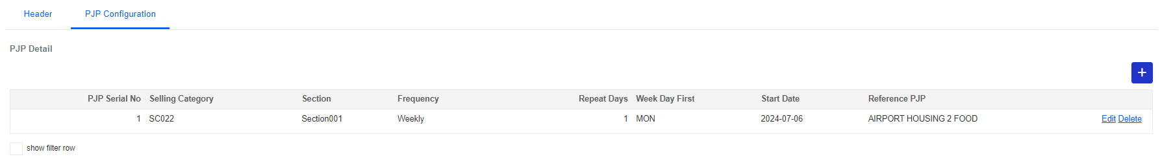
PJP Creation (4 of 7)
PJP Configuration Tab
The configuration tab allows users to associate the PJP with the required sections and selling categories to customize its functionality.
Fields Description
PJP Serial No: This field will be a sequential number which is auto-generated.
Selling Category: Select the appropriate selling category from the provided list. Only those selling categories permissible for the mapped DT will be visible in the dropdown.
Section: Select the section (logical grouping of outlets) to map it with PJP
Frequency: Select frequency that indicates how frequent the visits would be, selecting the one would appears on the PJP. Dropdown – Daily/Monthly/Weekly/Yearly
Repeat Days: Repeat Days is the number of days for the PJP, if it is Monthly and days defined are 5 then this means that PJP is for 5 days in the entire. And the corresponding field is further used to specify the days for the PJP.
Start Date: Start Date is the date for PJP to be started.
Reference PJP: Select the one Reference PJP that maps the Delivery Man PJP with Order Booker PJP. Every Order PJP must be linked to a delivery person PJP, and vice-versa. For the delivery app, the delivery PJP is mandatory. For non-delivery optimization (DT/non-Locus), a manual picklist will be generated based on the delivery person PJP and the cash memos of the order booker PJPs assigned to it.
Add Record: The user can create a new record by clicking the (+) button. This action enables the addition of as many rows as necessary.
Edit Record: Click edit to make changes to the existing entry.
Delete Record: To delete any specific record, simply click the delete.
Save: After entering the details, click save button to save the configuration.

Slide 9
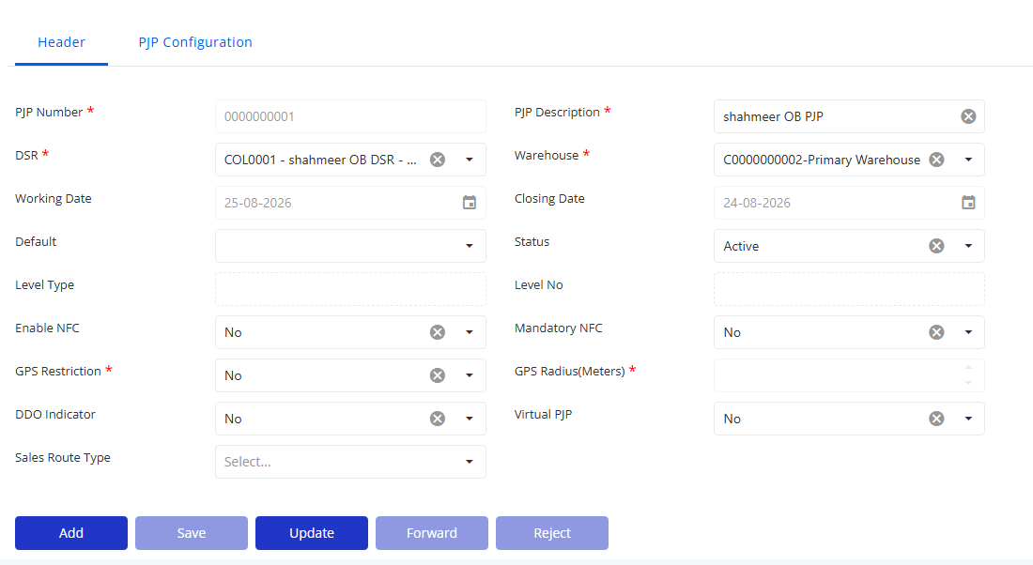
PJP Creation – Approval
Once a PJP header and configuration details have been filled, the user clicks on the ‘Forward’ button on the header tab to send the PJP request to TM user for approval.
Search
TM user searches for the PJP Creation into the search box located on the main page.
Home->Distributor Setup->Journey Plan->PJP Creation
TM user selects the required PJP which is pending for approval and clicks on the ‘Forward’/’Reject’ button to approve/reject the same. PJP Status is changed to Active once TM approved it.

Slide 10
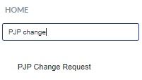
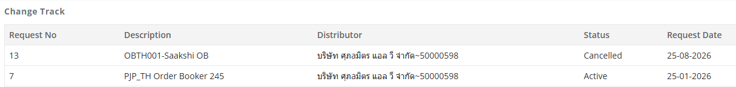
PJP Header – Update (1 of 2)
In this interface, users have the capability to modify specific attributes regarding PJP.
Search for ‘PJP Change Request’ in the menu
PATH: Distributor -> Journey Plan -> PJP Change Request
List of PJPs:
Upon accessing the screen, users will be presented with a comprehensive list of PJPs. This list displays all currently approved PJPs.
User can select the required record and update the fields in the PJP modification section

Slide 11
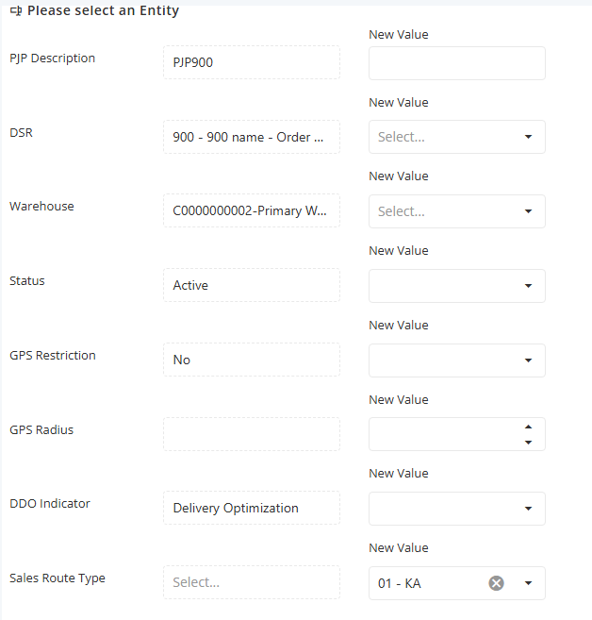
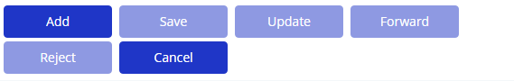
PJP Header – Update (2 of 2)
Field Description:
PJP Description: The name/title of the PJP. Enter the new description if any changes are required.
DSR: The DSR mapped to the PJP. Update if necessary.
Warehouse: The warehouse mapped to the DSR. Update if necessary.
Status: The current operational status of the DSR. Change if required.
GPS Restriction: Indicates whether GPS-based location restriction is enabled for the PJP.
GPS Radius: The permitted GPS radius for the PJP.
DDO Indicator: Indicates whether the DDO option is enabled for the PJP.
Sales Route Type: The sales route type assigned to the PJP.
Once the required changes are done, user clicks on the ‘Save’ button to save the same and then the ‘Forward’ button to send the request for approval

Slide 12
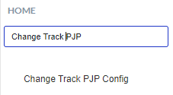
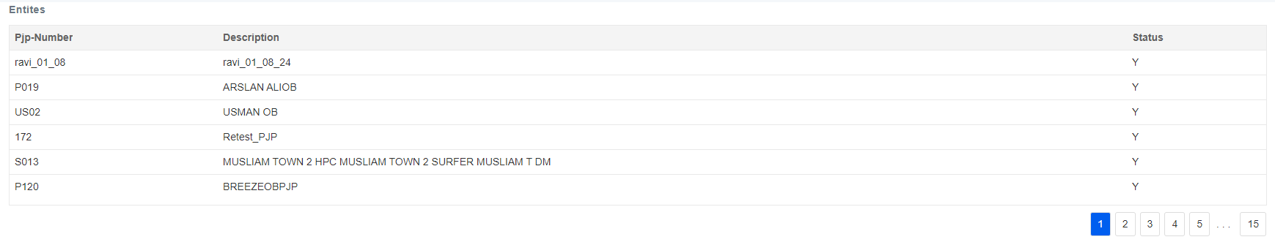
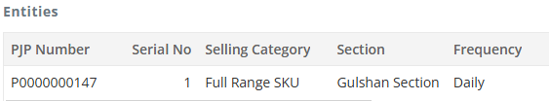
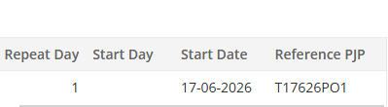
PJP Configuration – Update (1 of 2)
In this interface, users have the capability to modify the PJP configuration.
Search for ‘Change Track PJP Config’ in the menu
PATH: Distributor -> Journey Plan -> Change Track PJP Config
List of PJPs:
Upon accessing the screen, users will be presented with a comprehensive list of PJPs. This list displays all currently approved PJPs.
When user selects the required PJP, the corresponding PJP configuration records are displayed in the next grid.
User can then select the required PJP configuration record for modification.

Slide 13
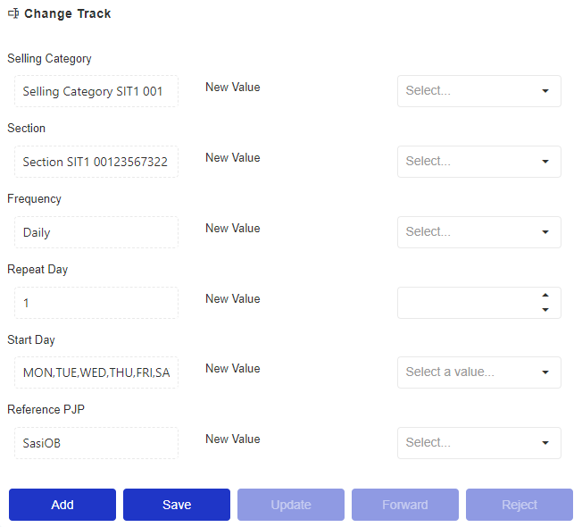
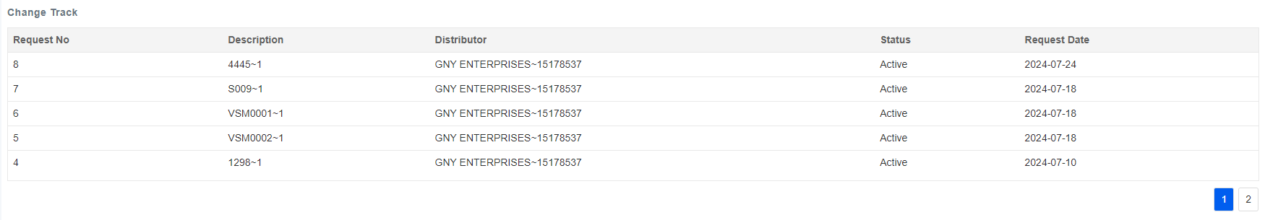
PJP Configuration – Update (2 of 2)
Field Description:
Selling Category: The selling category mapped to the PJP configuration. Update if necessary.
Section: The section mapped to the PJP configuration. Update if necessary.
Frequency: The frequency set up to the PJP configuration. Update if necessary.
Repeat Day: The no. of days the PJP configuration repeats in the selected frequency. Change if required.
Start Day: The starting day of the PJP configuration as per the selected frequency. Change if required
Reference PJP: The mapping of an order booker PJP to a delivery person PJP and vice versa. Change if required.
Once the required changes are done, user clicks on the ‘Save’ button to save the same and then the ‘Forward’ button to send the request for approval
Approve modification of PJP Configuration
To approve the modification of a PJP configuration, TM user will:
Navigate to the ‘Change Track PJP Config’ screen
All modification requests will be listed in the grid with the details – Request No, Description, Distributor, Status and Request Date
Select the required request
Review the submitted changes in attributes of the selected PJP configuration.
Click on the 'Forward' button to approve the modifications.

Slide 14
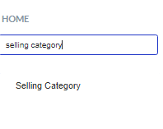
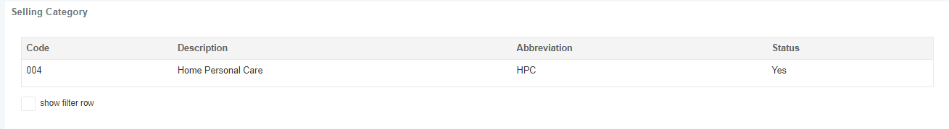
Selling Category - Create/Update (1 of 4)
Search
To locate a specific selling category, utilize the search function located on the homepage.
PATH: Company Setup -> General -> Selling Category
Existing Selling Categories
This section displays the list of all the existing selling categories.
The user can click on one of the rows to access the selling category of interest.
Upon selecting a selling category, all details corresponding to the selected selling category will be displayed.
The same screen can be used to create new or update existing selling categories.

Slide 15
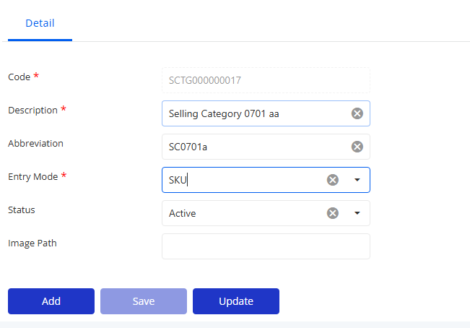
Selling Category- Create/Update (1 of 4)
Fields Description
Code: Unique selling category code to effectively differentiate each selling category.
Description: Description of the selling category for clarity and categorization purposes.
Abbreviation: Abbreviation of the selling category.
Entry Mode: Indicates the level to which the selling category is mapped for organizational purposes.
Status: Status of the selling category (Yes/No), indicating whether it is active or inactive.
Image Path: Path pointing to location where the image corresponding to the selling category has been placed.
Save Button
Once all the required information has been entered, the save button is clicked to save the information.

Slide 16
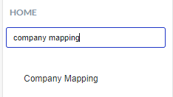
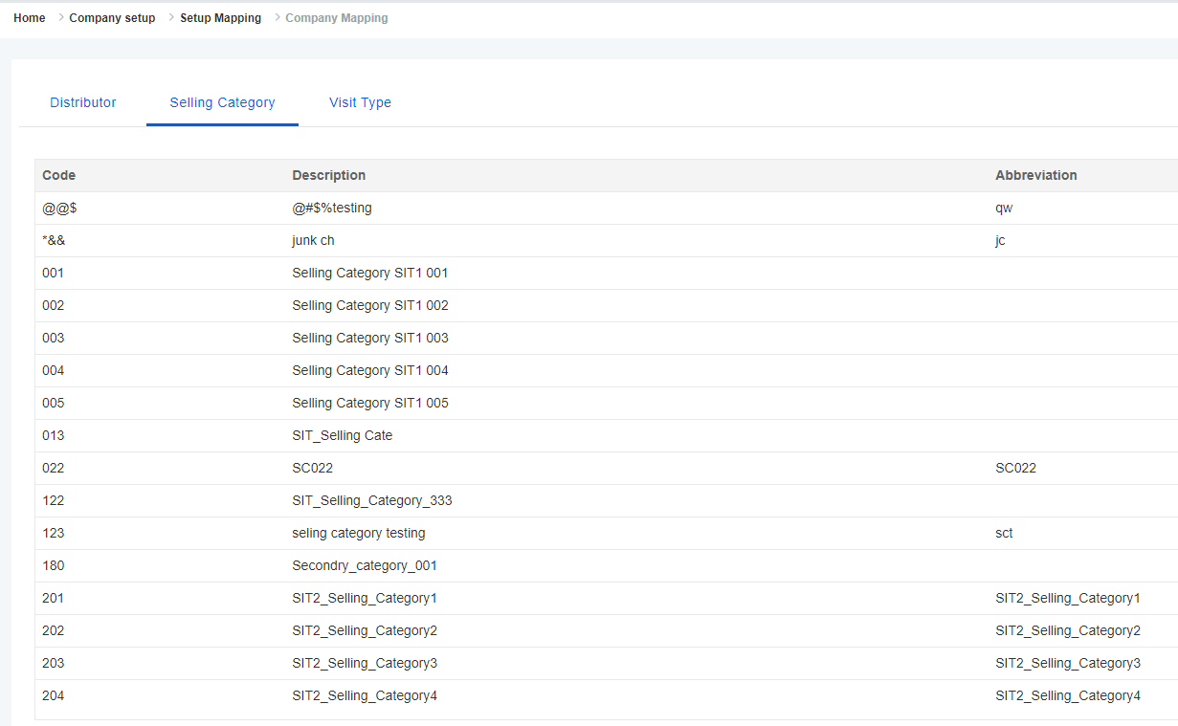
Selling Category- Create/Update (1 of 4)
Search
Navigate to the home page and utilize the search box to search the Company Mapping tile.
PATH: Company Setup -> Setup Mapping -> Company Mapping
Navigate to the Selling Category tab
This screen displays the company mapping interface, where the newly created Selling Category can be appropriately linked to the respective products.
Enabling the filter row will activate a search bar for keyword-based searches within the list.

Slide 17
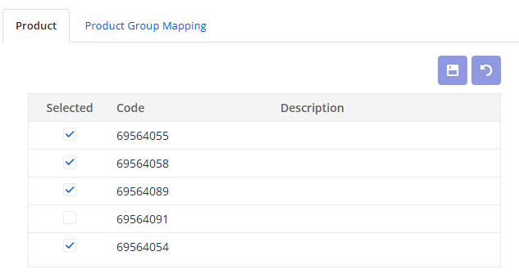
Selling Category- Create/Update (1 of 4)
Selling Category to Products Mapping
Choose a specific selling category from the list options.
All eligible products will be displayed under the "allowable" section.
Select the desired product(s) from the list.
Save the changes by clicking on the "save" icon or revert them by selecting "undo icon.“
The selected products(s) visibly move to the right section of the screen confirming successful mapping

Slide 18
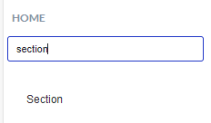
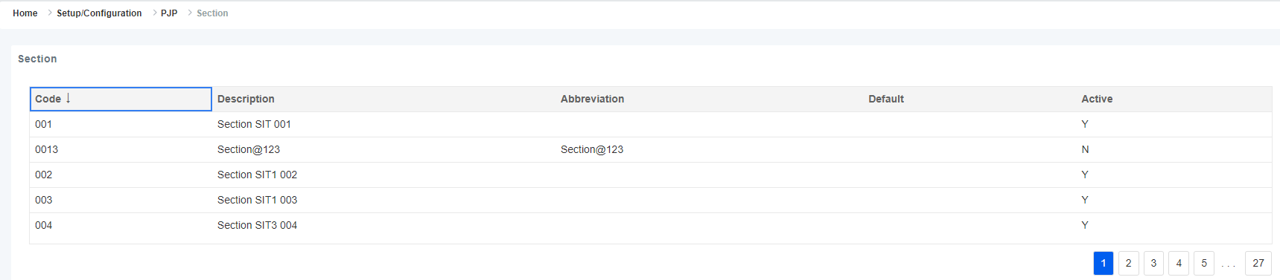
Section - Create/Update (1 of 6)
Search
Locate the “Section" tile within the search box on the home page.
PATH: Setup Configuration -> PJP -> Section
Existing Records
Previously created section will be displayed in this list. Clicking on any record from the list will display the respective details.

Slide 19
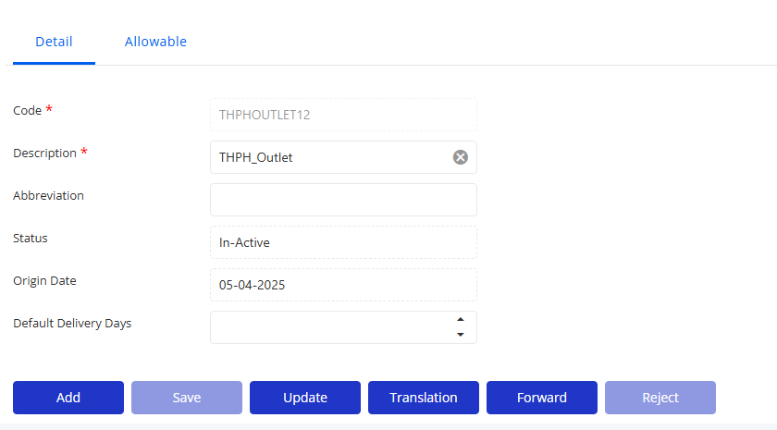
Section - Create/Update (2 of 6)
Creating New Section
To create a new section, click on the “Add" button in the ‘Detail’ tab.
Fields Description
Code: Unique code of the section
Description: Textual description of the section
Abbreviation: Abbreviation of the section
Status: Indicates if the section is ACTIVE or INACTIVE. Active means that the section is currently in use, inactive if the distributor no longer wants to use this section.
Origin Date: Date of origin of the section.
Default delivery days: The standard number of days required for delivery. Enter the number of days used to calculate the expected delivery date.
Save Button
Once all the required information has been entered, the save button is clicked to save the information.

Slide 20
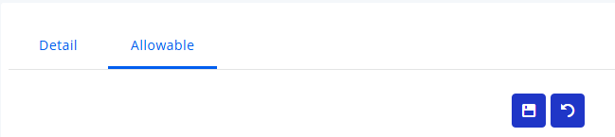
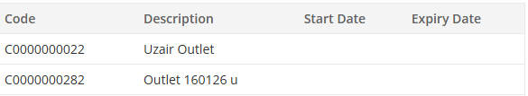
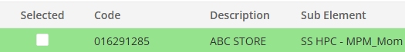
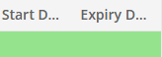
Section - Create/Update (3 of 6)
Once the section has been created, the new tab name ‘Allowable’ will be displayed.
On navigating to the ‘Allowable’ tab, all outlets that can be mapped to the section are listed in the left grid.
Select the required outlets and click on the save icon.
All outlets visibly move to the right grid confirming successful mapping

Slide 21
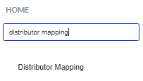
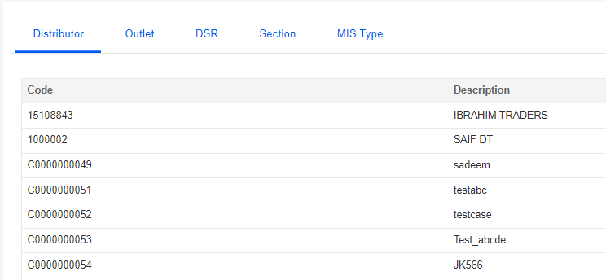
Section - Create/Update (4 of 6)
Search
Navigate to the search box on the home page and search for the "distributor mapping" tile. A section can be mapped to the required outlets from the ‘Section’ tab under Distributor Mapping screen as well.
PATH: Distributor Setup -> Setup Mapping -> Distributor Mapping
This section displays the list of all the existing data.

Slide 22
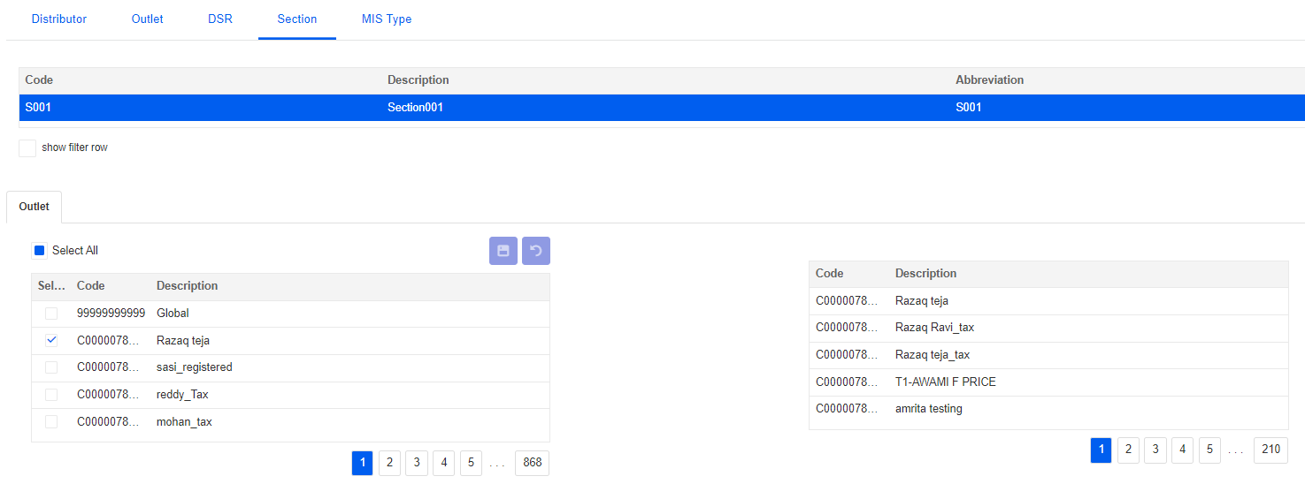
Section - Create/Update (5 of 6)
Navigate to the Section tab and select the required section
Mapping Procedure
All active outlets associated with the selected distributor will be listed
Choose one or multiple outlets from the list.
Utilize the filter row to search for specific outlets using keywords.
Click on the save icon to preserve your selections, or undo to revert any changes made.
The mapped records will then be displayed in a grid format on the right side of the screen.

Slide 23
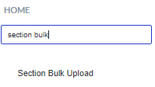
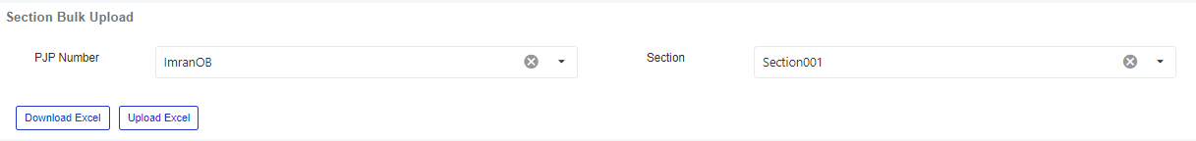

Section - Create/Update (6 of 6)
The mapping of a section to the outlets can be updated using an excel bulk upload process as well.
Search
Locate the “Section Bulk Upload" tile within the search box on the home page.
PATH: Distributor Setup -> Journey Plan -> Section Bulk Upload
Fields Description
PJP Number: Dropdown listing all PJPs.
Section: Dropdown listing all sections mapped to the selected PJP.
User can download the template by clicking on the ‘Download Excel’ button after selecting the required PJP number and Section.
Once the template has been downloaded, the user can make the required changes and upload the same using the ‘Upload Excel’ button.
If there is an issue with the template or the data, an error file will be downloaded with the appropriate error messages added in the last column of the excel file.
If there is no issue, a success message will be displayed, and the user can navigate to the ‘Section’ screen or the ‘Distributor Mapping’ screen to view the updates made.
Fields Description
Distributor Code: Unique Code of the Distributor to which the section has been mapped.
Section Code: Unique Code corresponding to the section to be updated.
Section Name: Name of the section to be updated.
Outlet Code: Unique code of the outlet to be mapped to the section.
Outlet Name: Name of the outlet to be mapped to the section. This is Outlet Long Name.

Slide 24
Conclusion
These slides encapsulate the complete integration of PJP into the distributor management system.
Each subsequent slide delves into the intricacies of this integration, illustrating the journey plan process flow.
The process encompasses defining selling categories and sections and mapping them with PJPs, essential components for streamlined operations.
This comprehensive approach ensures a smooth and organized PJP (journey plan) creation and configuration, optimizing our distributor management system for enhanced performance and productivity.
www.centegytechnologies.com
contact@centegytechnologies.com

Slide 25
Thank you
Digitize. Distribute. Transform.

